Slide 1
ENSE 374, Milestone 2
The Great Value
Azeezat, Krupal, Joseph, Clark, Martha
October 11, 2018

Slide 2
Content Review & Analysis
Engineering Home
The homepage is not responsive
In homepage there are links that are not working/updated (e.g. the News and Events link isn’t working, Monthly Newsletter link isn’t updated)
The links should not create a new tab because it decreases efficiency
The homepage is not very organized
Notes:
Go over key findings from your content review and analysis Might be interesting to look at each of the main sections at a high-level first and then dive into the details Engineering home Programs Students Faculty & Staff directory Contact us

Slide 3
Content Review & Analysis
Program Page
Each program has its own page with descriptions of what it’s about
Quick links section direct to the Students page. It should be quick links to the same page.
Quick links section should have a link that directs students to the program’s course lists
Each program should have tuition fees.
They could include some scholarship information for new and current students.
Notes:
Go over key findings from your content review and analysis Might be interesting to look at each of the main sections at a high-level first and then dive into the details Engineering home Programs Students Faculty & Staff directory Contact us

Slide 4
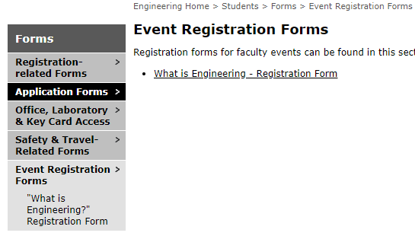
Content Review & Analysis
Student Page
The student page is very informative
There are lot of links
The home page of the student page does not provide important information.
News and Events link is not working
The main menu of students disappear when
entering to the forms link
Notes:
Go over key findings from your content review and analysis Might be interesting to look at each of the main sections at a high-level first and then dive into the details Engineering home Programs Students Faculty & Staff directory Contact us

Slide 5
Content Review & Analysis
Faculty and Staff Directory
Organized
Navigation is excellent
Each faculty member has a link to their homepage that’s very informative
All links work
Useful content
There should be a search option for looking for specific staff
Notes:
Go over key findings from your content review and analysis Might be interesting to look at each of the main sections at a high-level first and then dive into the details Engineering home Programs Students Faculty & Staff directory Contact us

Slide 6
Content Review & Analysis
Contact Page
The contact page is straight to the point, there’s no confusion on the navigation
There should be an inclusion on office hours.
FAQ’s section should be included in the contact page.
Notes:
Go over key findings from your content review and analysis Might be interesting to look at each of the main sections at a high-level first and then dive into the details Engineering home Programs Students Faculty & Staff directory Contact us

Slide 7
Removal of content proposals
The overhead navigation can be removed and all placed at the left side
There will be the Home, Student, Program, Faculty and Staff and Contact Us as the main one
There can be a drop down menu of the sub-sections
In the homepage there are two ways of accessing the contact us page, there should be only one
As of now there are currently two homepages, one is created using html and the other one is created in php file
In the left-side navigation bar there is a faculty and staff link there. This is unnecessary for students to access because it does not provide any help.
Notes:
Highlight the content your team has proposed for removal from the public site as being deemed for faculty/staff awareness/eyes only Be specific here Address the where and the why of it all (as much as you can) For pages/content you were unsure of, this is the time to discuss as well

Slide 8
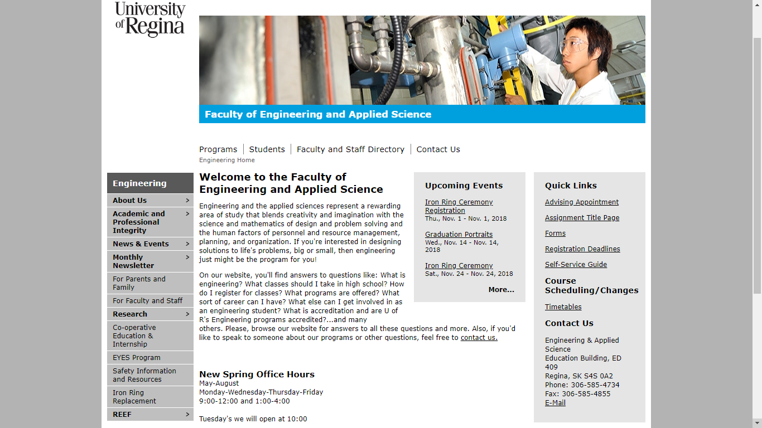
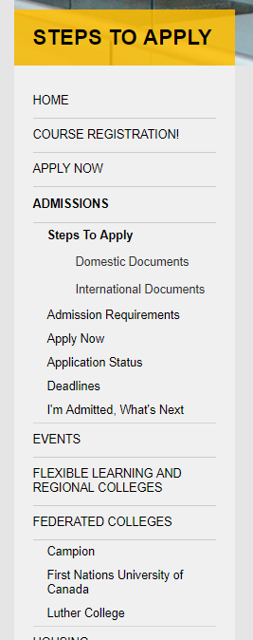
Removal of content proposals
Notes:
Highlight the content your team has proposed for removal from the public site as being deemed for faculty/staff awareness/eyes only Be specific here Address the where and the why of it all (as much as you can) For pages/content you were unsure of, this is the time to discuss as well

Slide 9
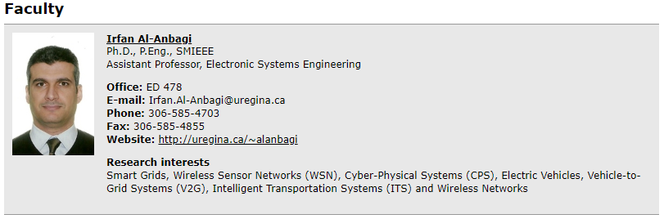
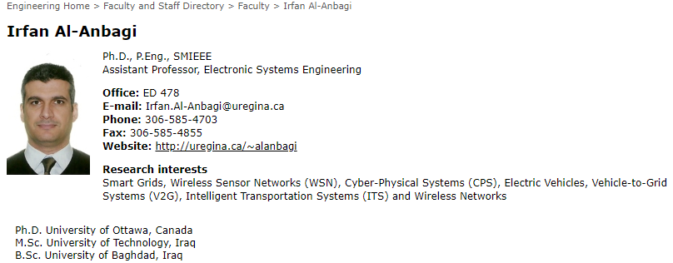
Removal of content proposals
There are some forms that could be removed from the student page like Laboratory Commissioning and Occupancy Approval. This form should be given as needed
In the Faculty and Staff directory, it is not necessary to have the detailed information about the professors as the link on their name leads to the detailed information.
Notes:
Highlight the content your team has proposed for removal from the public site as being deemed for faculty/staff awareness/eyes only Be specific here Address the where and the why of it all (as much as you can) For pages/content you were unsure of, this is the time to discuss as well

Slide 10

Group Reflection
About this milestone: We already know how we work as a group and are able to work efficiently. We liked the research phase of this milestone.
About ourselves: We go off topic most of the time, therefore decreasing our productivity.
In the future: Time management is important and everyone has to be responsible for their part.
Help needed? We weren’t really sure what to write for the removal of content. We were unable to find much content that should only be seen by faculty and staff.
Image taken from: http://homeschoolcpa.com/board-turnover-may-mean-the-purpose-of-the-homeschool-group-could-change/
Notes:
1. How did you feel about this milestone? What did you like about it? What did you dislike? 2. What did you learn about yourself as you collaborated and worked through this milestone? 3. How will you use what you have learned going forward? 4. What “stuff & things” related to this milestone would you want help with?
We learned that Krupal needs help in time management. He needs new friends that motivate him to do stuff. And be productive.Kru

Slide 11
Questions?

